Slide 1

wireless Motor Monitoring System
Prepare by :
Khalid Froukh (1833319)

Slide 2
Introduction
Wireless Motor Monitoring System: They are devices that calculate or do something remotely or automatically.
IoT has become a part of the modern world. The significance and utilization are increasing with each passing day. This approach is to design an efficient and real-time wireless network to monitor the voltage, current, and speed of the motor. A sensor is set at the heap to ascertain current, a circuit is utilized to figure voltage and with these two, power can be computed. A proximity sensor is used to monitor the speed of the motor. A microcontroller can take input from the device they controlling and retain control by sending the device signals to the Wi-Fi module. Wi-Fi module is a self-contained TCP/IP protocol stack that can give any microcontroller access to the Wi-Fi network. Data are stored in the cloud database.

Slide 3
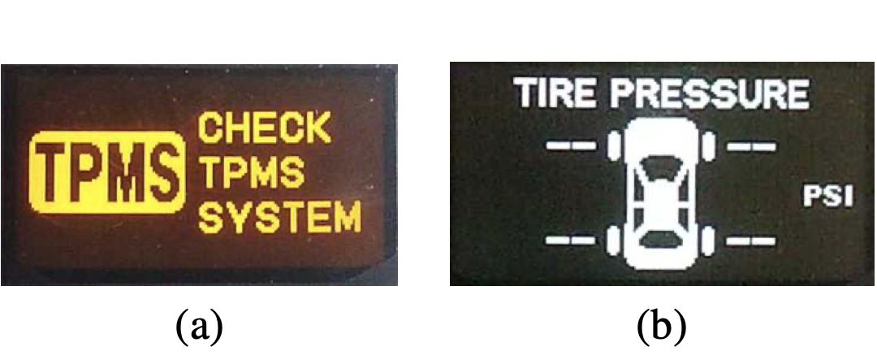
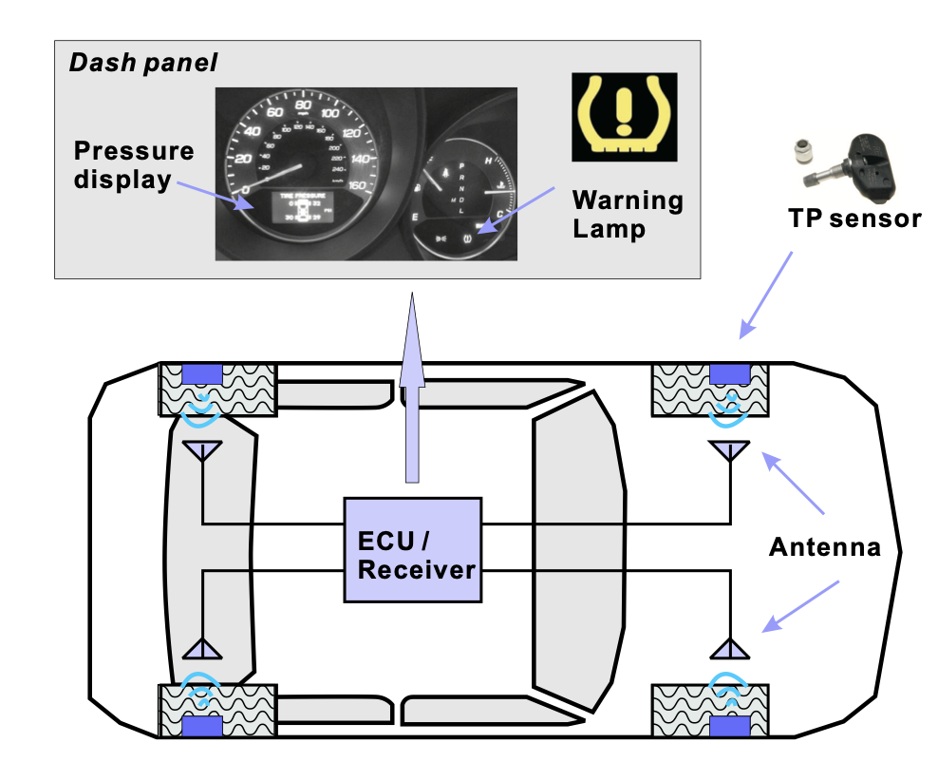
Introduction
wireless devices are known to present tracking risks through explicit identifiers in protocols or identifiable patterns in waveforms. Since automobiles have become an essential element of our social fabric — they allow us to commute to and from work; they help us take care of errands like shopping and taking our children to daycare — tracking automobiles presents substantial risks to location privacy. There is significant interest in wireless tracking of cars, at least for traffic monitoring purposes. Several entities are using mobile toll tag readers to monitor traffic flows. Tracking through the TPMS system, if possible, would raise greater concerns because the use of TPMS is not voluntary and they are hard to deactivate.
TMPS : Tire-pressure monitoring system

Slide 4
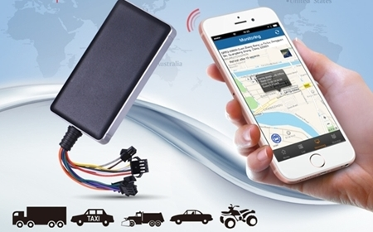
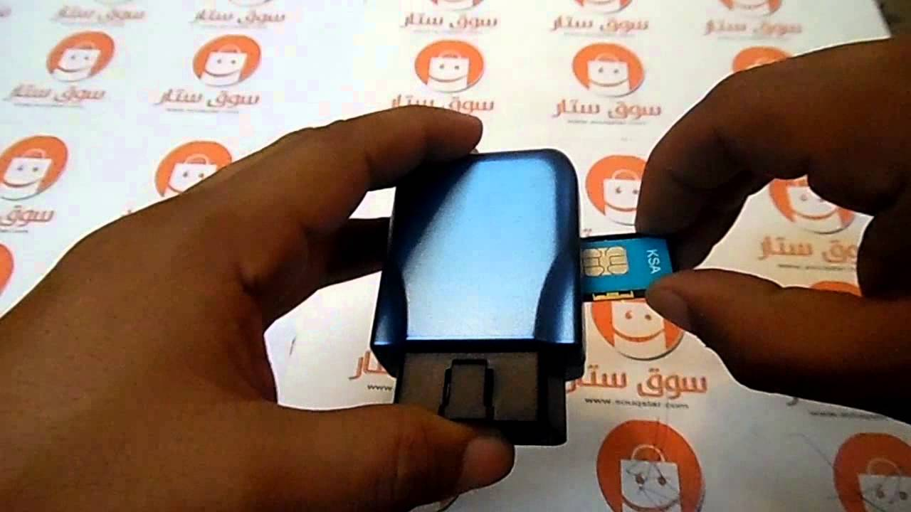
Provide safety
Using a wireless motor control system, from my point of view this device provides safety to its owner, for example, whoever owns a taxi or a car office for rent can put the wireless monitoring device and link it to a phone application that can :
monitor the location of the car when the last time it was started and how long the car remained They work
turn off the car remotely
stop some control tools inside the car
there are also devices added, for example determining the air pressure inside the tire and also the percentage of water and oils in the car.
This device gives you safety in the event of theft, locating it, and also knowing if the car owner used it incorrectly, and also inspects water and oils to preserve it.

Slide 5

Other uses
Also among the benefits of this device is the possible connection of home cameras, for example when there is a foreign object or strange movement that calls the emergency and makes a sound to keep the thieves away from the house and also can put it in the child's room to sense his movement or when he moves out of his bed trying to get out of it by issuing an alert to the phone or a warning sound to alert Parents do so.

Slide 6

How the tank sensor works
Where it is installed when installed in water tanks and linked either in a device that flashes with 3 colors, for example, green when full, blue when half the amount runs out, and red when the water is about to end, or linked to an application on a mobile phone that calculates these readings and determines the number of available liters and also this applies to owners Oil factories and petrol station owners.

Slide 7

Advantage
the wonderful features of the wireless surveillance devices are the ease of installation, the absence of wires and their connection in limited distances , and adherence to them.
The cost, too, many people think that wireless equipment is very expensive, but this is true when it starts, but when it is maintained and the problems that follow it, its cost is much lower than wired devices.
Energy in wireless devices works either by battery or by generating power by itself, that is, it does not need a power provider to work.

Slide 8
Disadvantage
Narrow or limited temperature range
he greater the exposure to the target gas, the shorter the life span.
Problems reading the data at times

Slide 9

Conclusion
at the end of this simplified explanation about wireless motor control system provides wireless motor control system Many services that help us, save time and effort, and also warn us before any damage occurs and provide a high level of safety, for example when your car is stolen, stopping its activity and determining its location, and also when warning us when people come at late dates to the home or when we are not present and also warn us when our child does actions that may lead to Harming him and also when we were told about the percentage of water in our tanks, and he was careful about its approaching running out and for the owners of the oil factories.

Slide 10

Development
it did a wonderful job and developed over the years, as it was in the past, for example, that it sensed the tanks of gas stations through a box with lights that determined the amount of available petrol and it had several disadvantages :
lighting problems may arise
going to the place where the box is located
The development that has occurred now is to create an application on the mobile phone through which you can see the amount of available fuel and notify us when it is approaching its expiration rate or determine when the gasoline reaches a specific amount.

Slide 11

my opinion
this service has provided us with a wonderful work, so we can monitor all things while we are anywhere and the features that have are much better than the features that wired devices give us, and the negatives that they have can be solved in the future (I am sure of that) so that is a good choice for you if you are Confused about bringing a wireless device to monitor a certain thing

Slide 12
Refrences
International Research Journal of Engineering and Technology (IRJET)
www.irjet.net
BRIK, V., BANERJEE, S., GRUTESER, M., AND OH, S. Wireless device identification with radiometric sig- natures. In Proceedings of ACM International Confer- ence on Mobile Computing and Networking (MobiCom) (2008), ACM, pp. 116–127.
ortable, solar-powered tag readers could improve traffic management. Available at http://news.rpi.edu/update.do?artcenterkey=1828.
https://www.pressac.com/insights/wired-or-wireless-sensors/
wikipedia

